Slide 1
How to describe places
Useful words to make your text stand out.

Slide 2
How to describe a place
Ancient
beautiful
Boring
Bustling
Athens is an ancient city.
Synonym: historic
Paris is very beautiful in the spring.
Synonym: lovely, attractive
Ptolemaida is a boring placed to live.
Synonym: uninteresting / dull
New York is a bustling city. One of its nicknames is “The city that never sleeps”
Synonym: lively, fast-paced, hectic

Slide 3
Charming
Oxford is a charming English city, which is stepped in history.
Synonym: quaint, delightful
Contemporary
Manchester is a northern city with a very contemporary, modern feel.
Synonym: modern, up-to-date
Compact
Rethymno is a compact city. You don’t need transport to get around.
Synonym: small
Cosmopolitan
Monaco is a cosmopolitan and culturally diverse country.

Slide 4
Exciting
Crowded
Popular
Picturesque
Touristy
Polluted
The seaside ton of Blackpool offers plenty of exciting activities for kids.
Synonym: lively, fun, thrilling
London can get really crowded during the summer months.
Synonym: busy, bustling
York is a historic British town which is very popular with tourists.
Synonym: famous
Chania is a picturesque seaside city of Crete.
Synonym: charming, quaint
Santorini can be a bit touristy and crowded during the summer
Delhi is a polluted city of India.
Synonym: dirty, contaminated

Slide 5
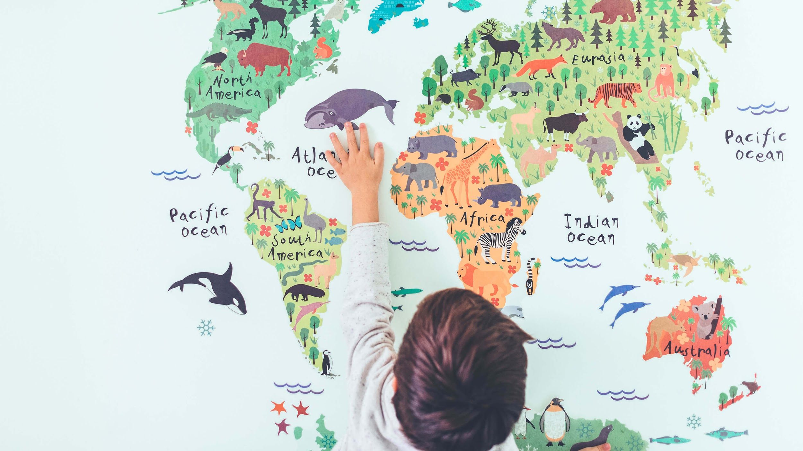
A Picture Is Worth a Thousand Words

